Slide 1

Build a Battery Classroom Game

Slide 2
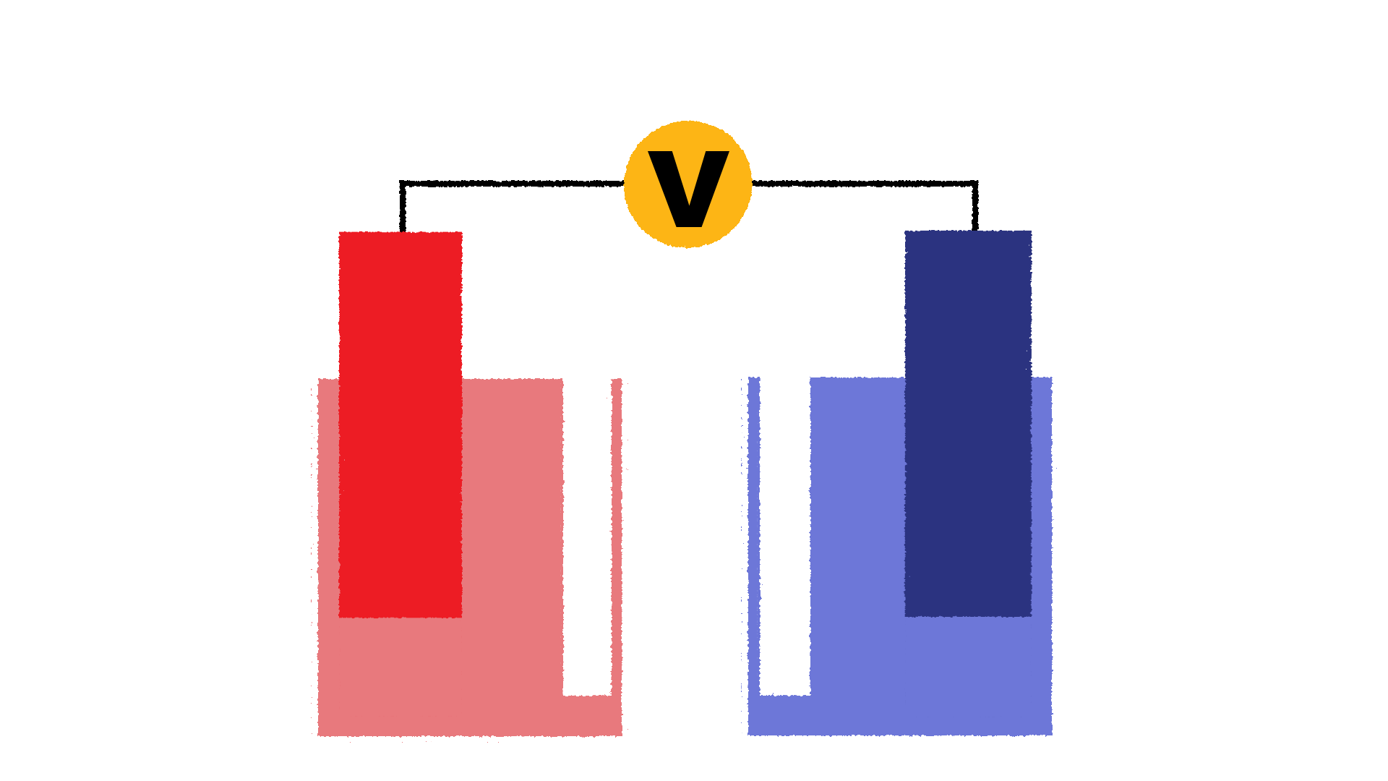
Chemical Cell
Voltmeter
Anode
Cathode
Zn
Cu
Salt Bridge
Electrolyte

Slide 3
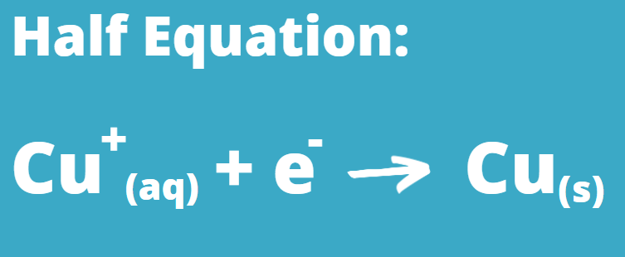
Cathode
Cu
At the Cathode, reduction occurs.
Reduction is the process of an ion gaining electrons to form a neutral atom.

Slide 4
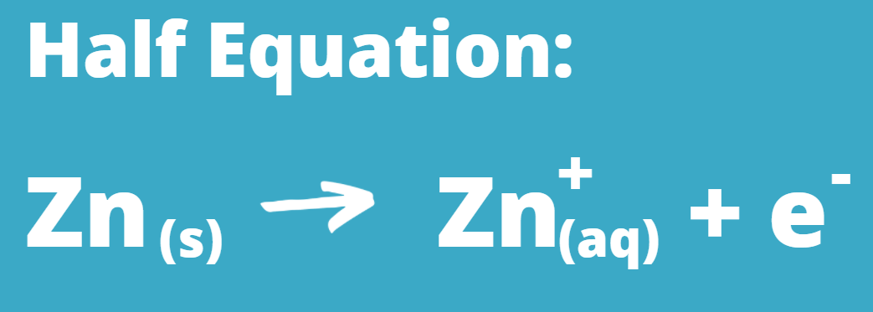
Anode
Zn
At the Anode, oxidation occurs.
Oxidation is the process of an atom losing electrons, to form a negatively charged ion.

Slide 5
A Redox Reaction Occurs
Zn
Cu
Electron
Positive Ion

Slide 6
A Redox Reaction is when an Oxidation and Reduction occurs at the same time.
At the Cathode, reduction occurs.
At the Anode, oxidation occurs.

Slide 7

A Battery is a Chemical Cell
Anode
Anode
Cathode
Cathode
Electrolyte
Electrolyte

Slide 8

The Flow of Electrons from the battery’s anode while discharging powers the Tablet

Slide 9
Build a Battery Classroom Game
Batteries can be made in many different ways, leading to the batteries having different properties. Some batteries are more sustainable or more safe than others.
The game uses cards to represent the different parts of the battery that you will build.

Slide 10
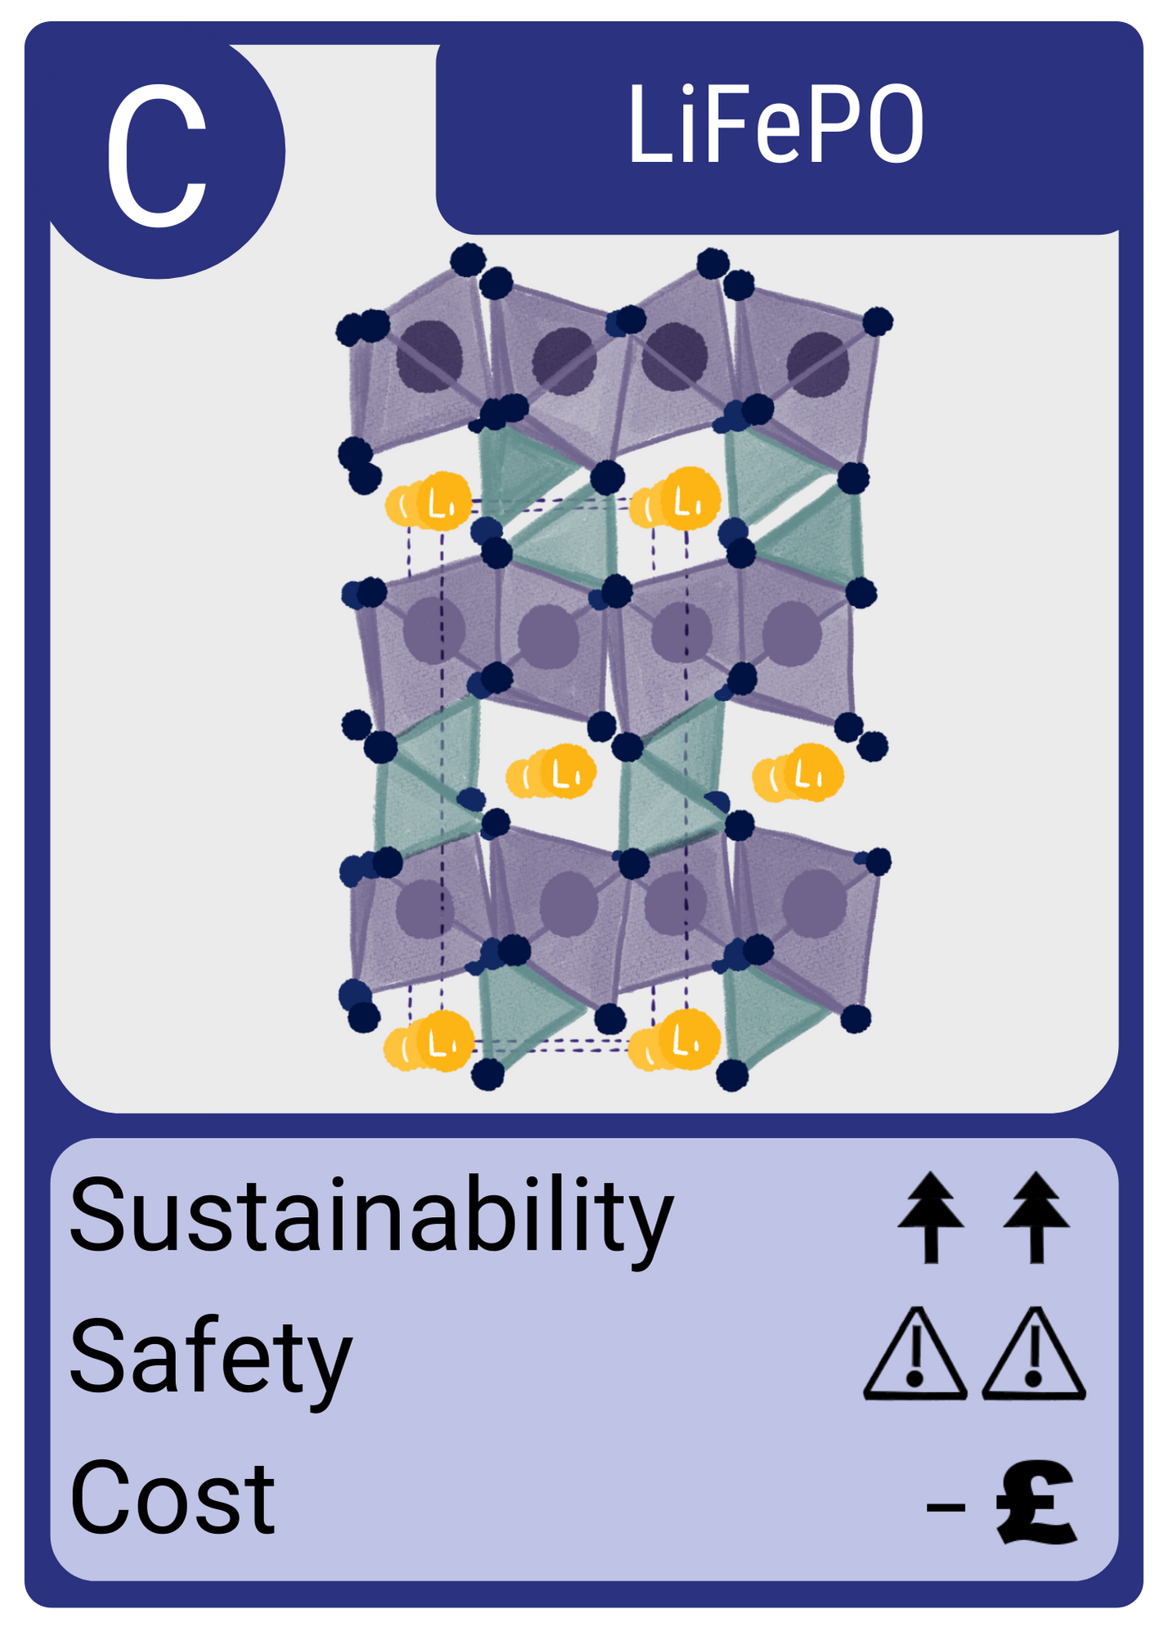
Example of a Cathode Card

Slide 11
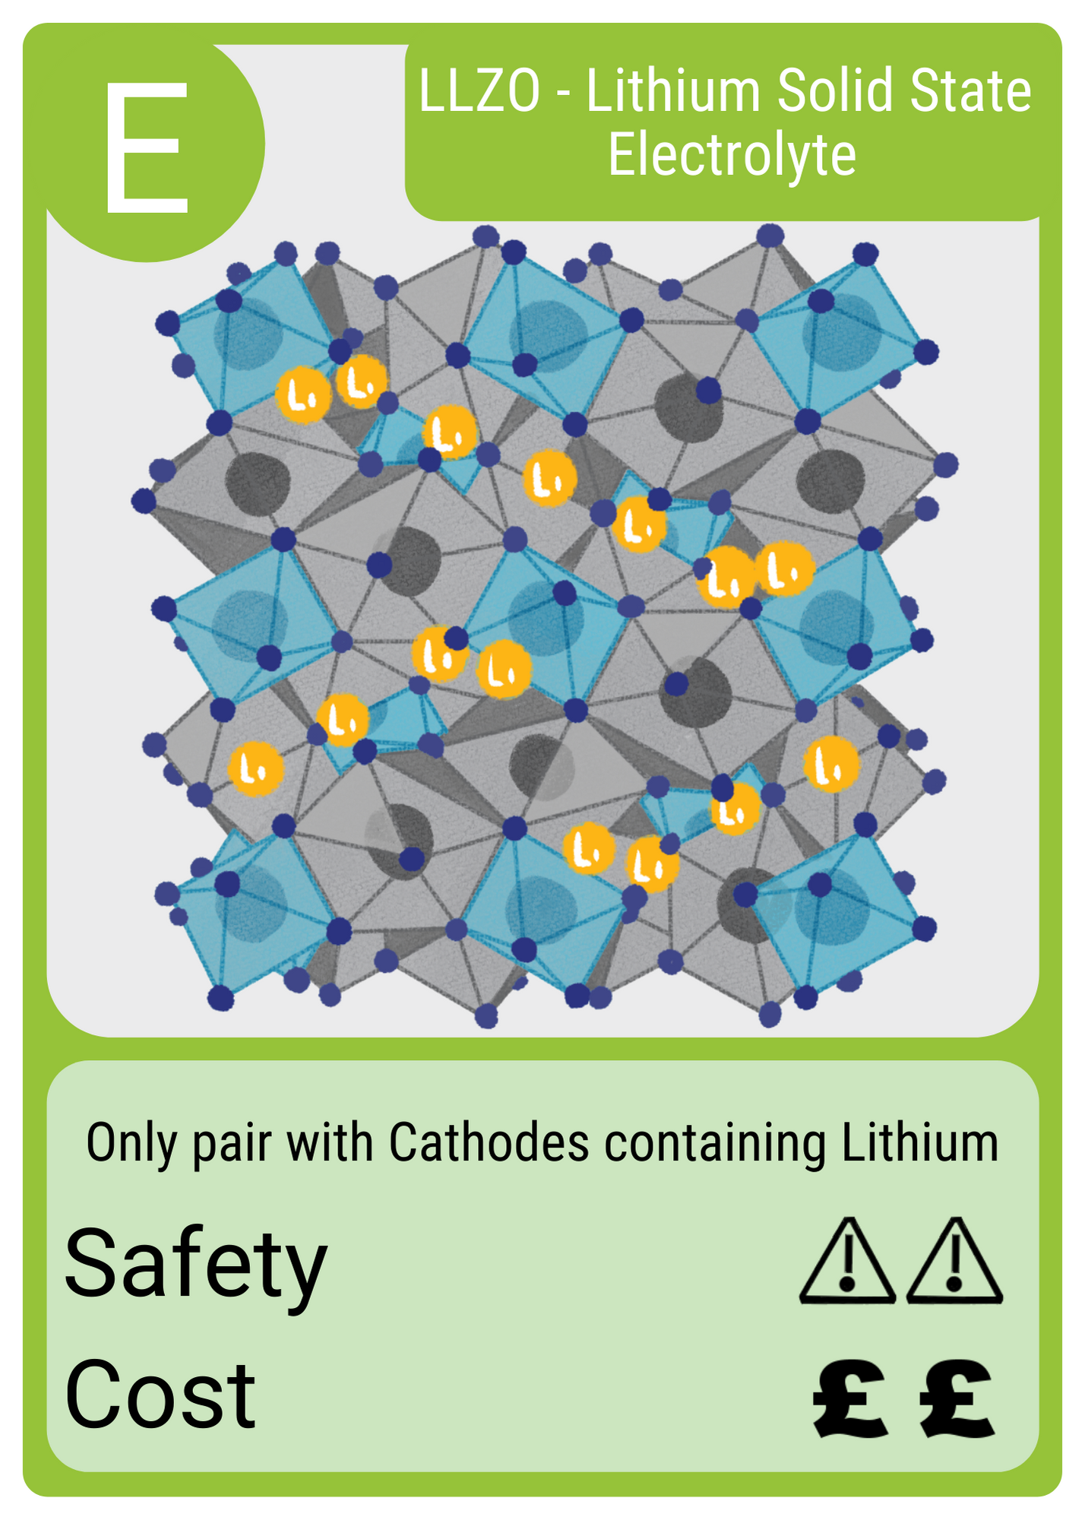
Example of an Electrolyte Card

Slide 12
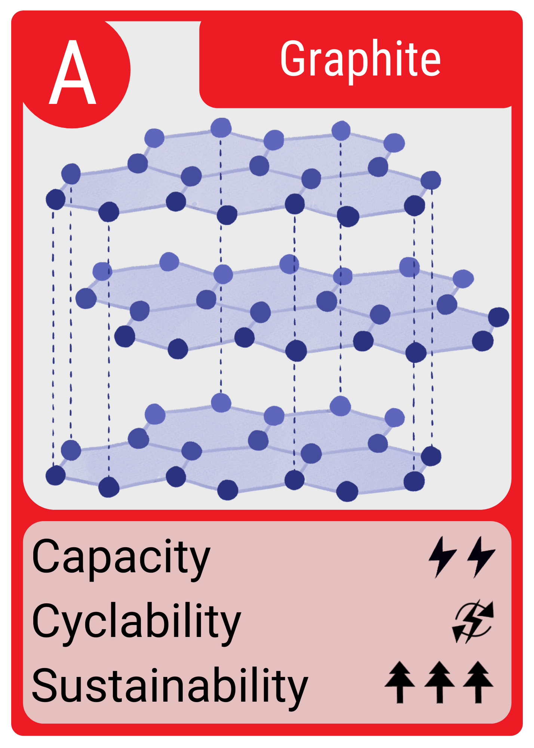
Example of an Anode Card

Slide 13
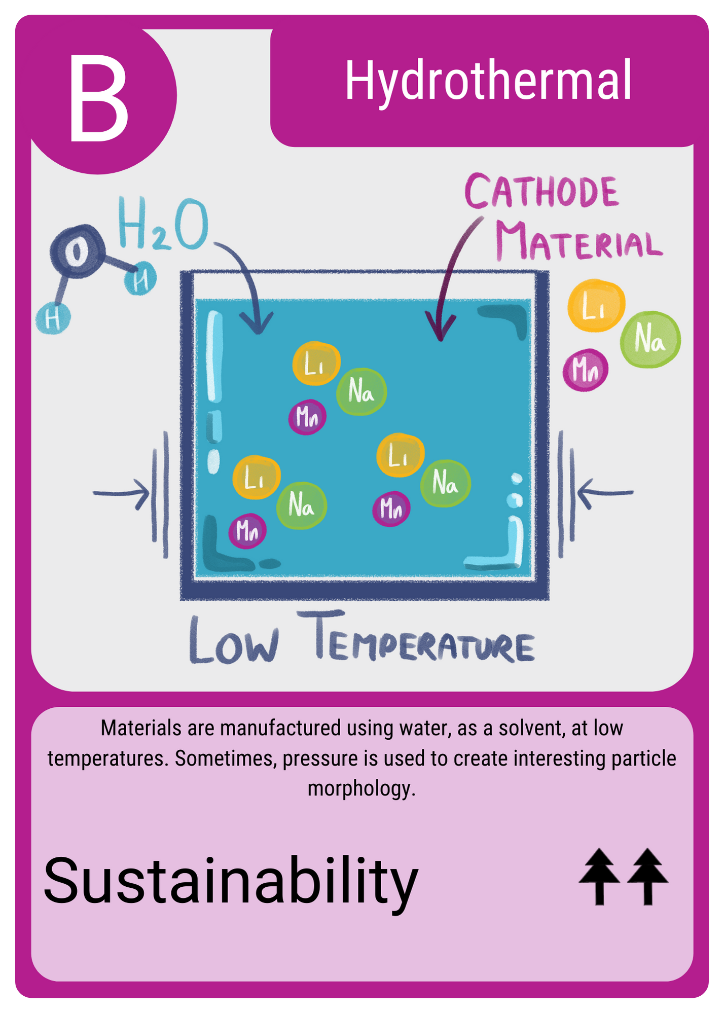
Example of a Bonus Card

Slide 14

What are the Battery Characteristics on the playing cards?

Slide 15

Capacity
This characteristic is based on the materials theoretical capacity.
Theoretical capacity is a prediction made by scientists. It predicts the maximum amount of energy the material could produce if everything went perfectly.
For cathode materials, this is often calculated using computer programs.
There is also an experimental capacity, found through testing the material.
This is similar to theoretical yield compared to experimental yield
of chemical reactions.

Slide 16

Cyclability
This is about the number of times the battery can complete a charge and discharge cycle.
The charge/discharge cycle is not perfect, so over time ions in the battery do not complete the whole cycle. This reduces the capacity of the battery, since less ions are transferring energy.
This is called battery degradation. Scientists want to improve battery’s lifetime by reducing battery degradation.

Slide 17

Safety
Battery safety is very important. Battery are used in many everyday applications, in our houses, pockets and in our cars.
A battery explosion is dangerous and can be difficult to fix.
Therefore, it is important batteries are safe to protect us.

Slide 18

Sustainability
There is a large drive to make batteries more sustainable.
Sustainability is important for protecting our resources and planet. Currently, most commercial batteries use Lithium and Cobalt, that have concerns about abundance and unethical mining.

Slide 19

Cost
This is a simple one, it is the cost of the materials.
However, there are many hidden factors affecting the cost:
The Abundance of the material
Mining or Extracting the Material
The processing and manufacture of the material so it is fit for the application

Slide 20
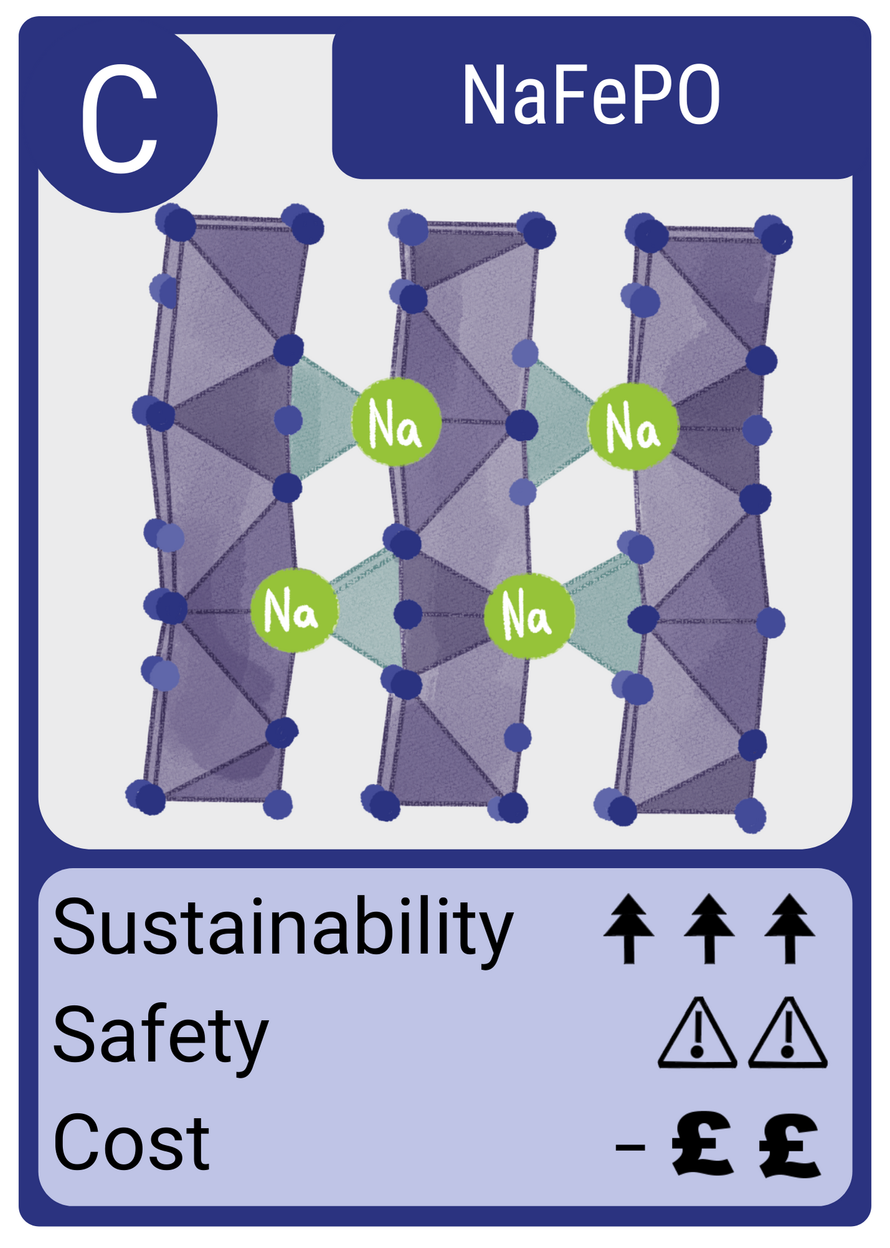
Rules for Making a Battery
To make a battery you must have: 1 Cathode card, 1 Electrolyte card and 1 Anode card.
These are all key points of a battery and it cannot be considered complete if you are missing one.
There is the option to include 1 Bonus card to your battery to improve it.

Slide 21
How to Win?
The teacher will organise the class being split into groups.
Each group of around 5-6 students, will receive 6 cards each.
The teacher will display application cards which contains battery characteristics (energy density, cyclability, sustainability, safety and cost).
You need to look at your cards as a group and by playing the rounds, get the best number of points that match the application card with a cathode, anode and electrolyte, plus any bonus cards you have.

Slide 22
TIME TO PLAY!

Slide 23
Round 1- Rotation
A type of Card is selected (cathode, electrolyte anode or bonus) and each team has to give one of their card of that type to the group on their left.

Slide 24
Round 2- Selection
Each group nominates one person to swap cards with another group.
The cards swapped must be the same type of card, so at the end of the round, each team has the same distribution of cards. So if it is cathodes, just cathodes are swapped.
This is done with the group on the right.
For example, group 1 nominates Ann and she goes to group 2 and selects one of their cathode cards and swaps it with a group 1 card.
Each team can just show the cards they have (e.g. cathode) in that category.

Slide 25
Round 3- Trading
Groups have an opportunity to trade cards.
Any type of card can be traded for another, but groups should remember they still need 1 Cathode, 1 Electrolyte and 1 Anode to build their battery and win.
A group member is nominated to address the class. They state the card they want to trade (ie. electrolyte card with ++ safety) and the card they want to receive (ie anode with one + or more for sustainability).
No one is forced to trade, but each group is given an opportunity to.

Slide 26
Time To Calculate the Scores and Find The Winners

Slide 27
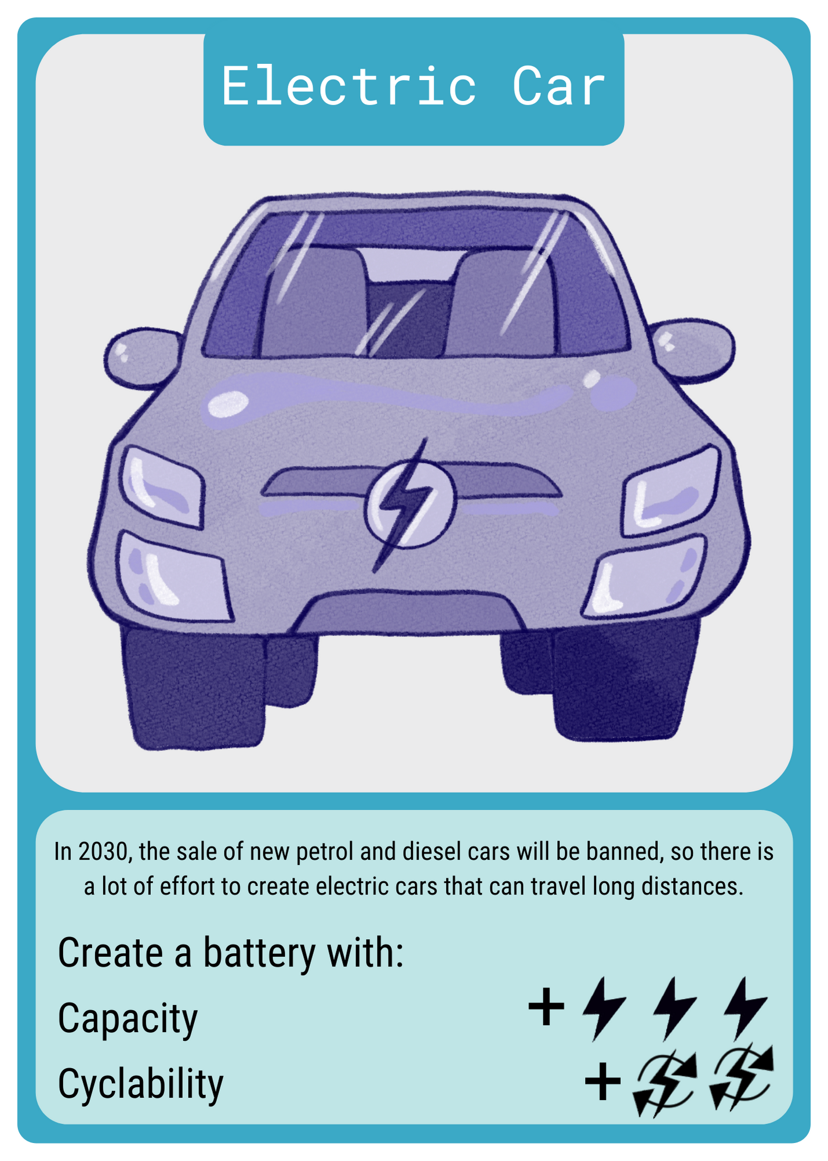
Who's the winner?
The winning group is the team who matches their 'hand' closest to the application card they have. For example, you would need 3 capacity points and 2 cyclability points to win this application card.
If there is a 'draw' between teams, then the teacher can show
a new application card and the teams can see if they
can match that with the hand they currently hold
and the nearest characteristic scores
(e.g. 3 capacity points rather than 2 capacity points wins)

Slide 28
Well Done!

Slide 29
For more information on The Faraday Institution: https://faraday.ac.uk/
For more information on FutureCat research group: https://futurecat.ac.uk/

